Slide 1
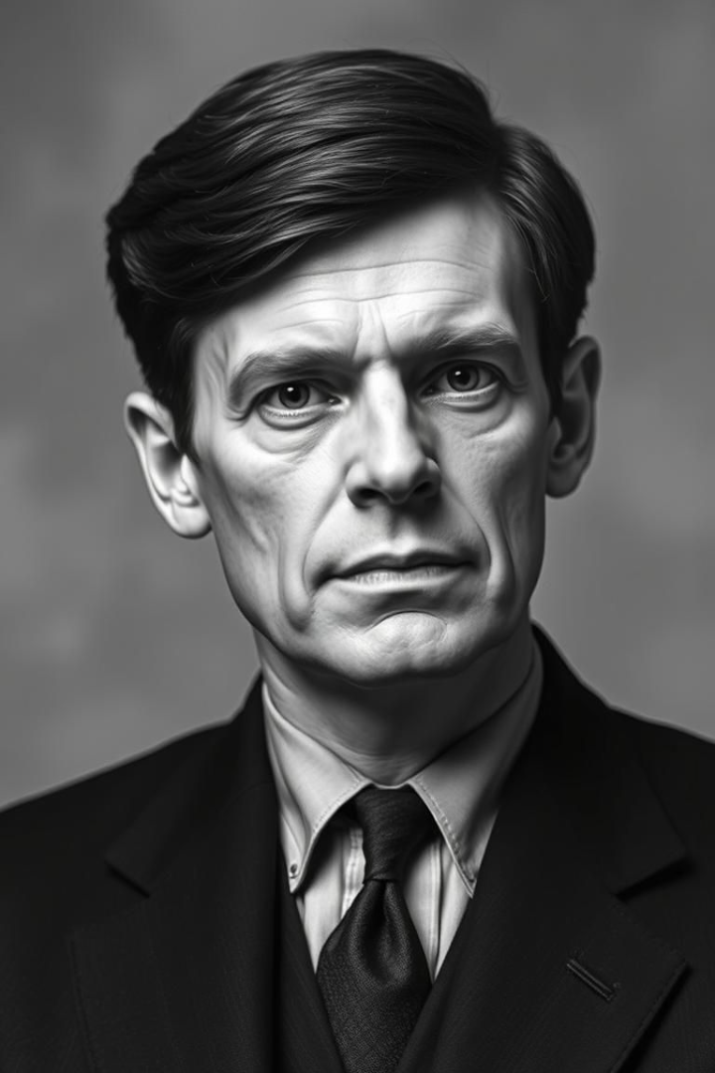
Alan Turing: Architect of the Digital Age
Alan Turing was a brilliant British mathematician and computer scientist. His work laid the groundwork for modern computing and artificial intelligence. Despite his immense contributions, he faced tragic persecution. Turing's story is a powerful reminder of the importance of acceptance and recognizing true genius.

Slide 2
Breaking the Enigma: A War Hero's Code
The Bombe Machine
Impact on the War
During World War II, Turing designed the Bombe machine.
It's estimated the codebreaking shortened the war by 2-4 years.
This electromechanical device helped break the German Enigma code. It could test 158 quadrillion settings.
His work saved millions of lives.
Sometimes it is the people no one imagines anything of who do the things that no one can imagine.

Slide 3




The Turing Machine: Blueprint for Modern Computing
The Concept
Turing created an abstract model of computation.
Key Elements
It consisted of an infinite tape and a read/write head.
Theoretical Significance
It laid the foundation for the limits of computation and algorithms.
All modern computers are based on Turing's conceptual model. This innovative concept was developed in 1936, long before the first electronic computers existed.

Slide 4




Artificial Intelligence Pioneer: The Turing Test
The Test
Machine
Human
Turing proposed a test for machine intelligence. Can a machine convince a human it is also human? This remains a benchmark and debate topic in AI.
In 2014, "Eugene Goostman" passed the Turing Test at the Royal Society.

Slide 5
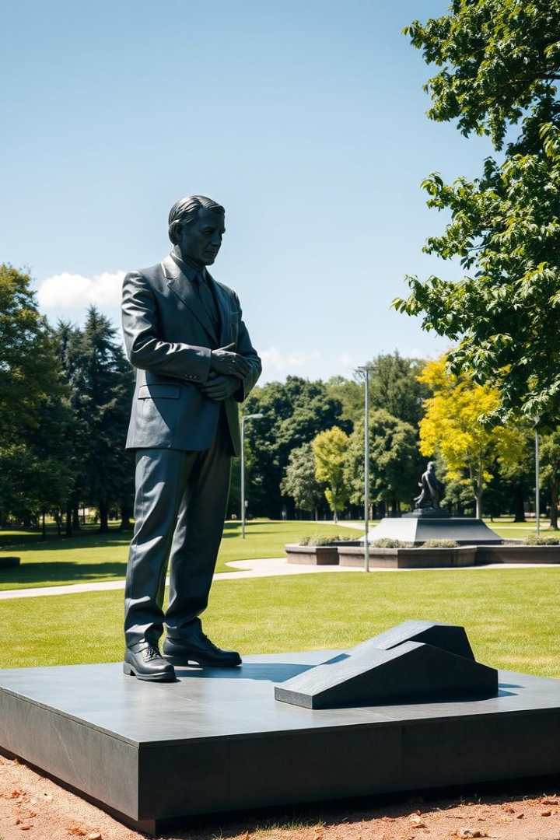
Legacy and Recognition: A Pioneer Remembered
Persecution and Apology
Turing faced prosecution for his homosexuality.
He received an official posthumous pardon in 2013.
The Turing Award
The highest distinction in computer science.
It is equivalent to the Nobel Prize.
Let us reflect on Turing’s contributions. Remember the importance of inclusivity in STEM fields. Support future generations of innovators.

